Slide 1
Introduction to Classification
Swarna Chaudhary
Assistant Professor
swarna.chaudhary@pilani.bits-pilani.ac.in

Slide 2

The slides presented here are obtained from the authors of the books and from various other contributors. I hereby acknowledge all the contributors for their material and inputs.
I have added and modified a few slides to suit the requirements of the course.

Slide 3
In this segment
Evaluation Plan
Modular Structure
Introduction to Classification
Introduction to Classification
Applications
Types of classification
Case study

Slide 4
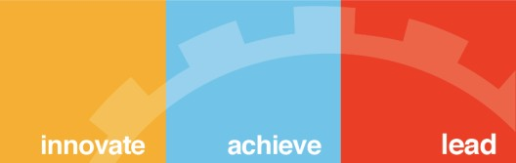
Textbooks/Reference Books
T1 | Christopher Bishop: Pattern Recognition and Machine Learning, Springer International Edition
T2 | Tom M. Mitchell: Machine Learning, The McGraw-Hill Companies, Inc.
R1 | An Introduction to Data Mining – Pang-Ning Tan, Michael Steinbach, Anuj Karpatne, Vipin Kumar
4
3 February 2021
BITS Pilani, Pilani Campus

Slide 5
Evaluation
Evaluation Component | Marks | Type
Comprehensive Examination | 40% | Open
Quizzes (3) | 24% | Open
Assignments (4) | 36% | Open
BITS Pilani, Pilani Campus

Slide 6
Modular Structure
No | Title of the Module
M1 | Introduction to Classification
M2 | Nearest-neighbour methods – kNN classifier
M3 | Naïve Bayes Classifier
M4 | Logistic Regression
M5 | Decision Tree
M6 | Optimization Foundations for Support Vector Machines
M7 | Support Vector Machines
M8 | Support Vector Machines in overlapping class distributions & Kernels
M9 | Ensemble Methods

Slide 7
Introduction to Classification
Classification refers to a predictive modeling problem where a class label is predicted for a given example of input data.
Many practical decision-making tasks can be formulated as classification problems
customers who are likely to buy or not buy a particular product in a supermarket
Detecting spam email messages based upon the message content
Categorizing tumors as malignant or benign based upon the results of MRI scan
people who are at high, medium or low risk of acquiring a certain illness
houses that are likely to rise in value, fall in value or have an unchanged value in 12 months' time
people who are likely to vote for each of a number of political parties (or none)
the likelihood of rain the next day for a weather forecast (very likely, likely, unlikely, very unlikely).
Classifying credit card transactions as legitimate or fraudulent
Categorizing news stories as finance, weather, entertainment, sports

Slide 9
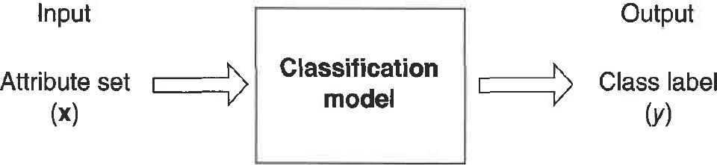
Introduction to Classification
Classification is the task of learning a target function f that maps each attribute set x to one of the predefined class Iabels y
Feature / Attribute – Input attribute that’s used in classifying the output
Feature set – Set of attributes that govern the output class
Label – Output class that the object is assigned to

Slide 10
Supervised vs. Unsupervised Learning
Supervised learning (classification)
Supervision: The training data (observations, measurements, etc.) are accompanied by class labels indicating the class of the observations
New data is classified based on the training set
Unsupervised learning (clustering)
The class labels of training data is unknown.
Also, number of classes to be learned may not known in advance.
Given a set of measurements, observations, etc. with the aim of grouping a set of objects in such a way that objects in the same group (or cluster) are more similar to each other than to those in other groups (clusters).
Eg. Marketing: Helps to discover distinct groups in their customer bases, depending on their buying patterns and then use this knowledge to develop targeted marketing program.

Slide 11
Prediction Problems: Classification vs. Numeric Prediction
Classification
predicts categorical class labels (discrete or nominal)
classifies data (constructs a model) based on the training set and the values (class labels) in a classifying attribute and uses it in classifying new data
Numeric Prediction
Models constructed predicts continuous-valued functions, i.e., predicts unknown or missing values
Suppose that the marketing manager wants to predict how much a given customer will spend during a sale.

Slide 12
Classification—A Two-Step Process
Model construction: describing a set of predetermined classes
Each tuple/sample is assumed to belong to a predefined class, as determined by the class label attribute
The set of tuples and their associated class labels, used for model construction is training set
The model is represented as classification rules, decision trees, or mathematical formulae
Model usage: for classifying future or unknown objects
Estimate accuracy of the model
The known label of test sample is compared with the classified result from the model
Accuracy rate is the percentage of test set samples that are correctly classified by the model
Test set is independent of training set (otherwise overfitting)
If the accuracy is acceptable, use the model to classify new data
Note: If the test set is used to select models, it is called validation (test) set

Slide 13

Illustrating Classification Task
Tid | Attrib1 | Attrib2 | Attrib3 | Class
1 | Yes | Large | 125K | No
2 | No | Medium | 100K | No
3 | No | Small | 70K | No
4 | Yes | Medium | 120K | No
5 | No | Large | 95K | Yes
6 | No | Medium | 60K | No
7 | Yes | Large | 220K | No
8 | No | Small | 85K | Yes
9 | No | Medium | 75K | No
10 | No | Small | 90K | Yes
Learning algorithm
Induction
Learn Model
10
Training Set
Model
Apply Model
Tid | Attrib1 | Attrib2 | Attrib3 | Class
11 | No | Small | 55K | ?
12 | Yes | Medium | 80K | ?
13 | Yes | Large | 110K | ?
14 | No | Small | 95K | ?
15 | No | Large | 67K | ?
Deduction
10
Test Set

Slide 14
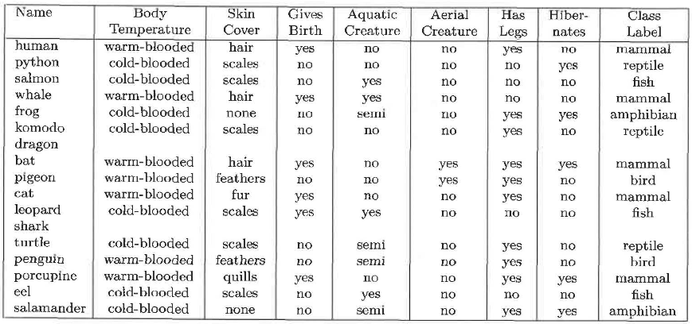
Example
Dataset
Prediction

Slide 15
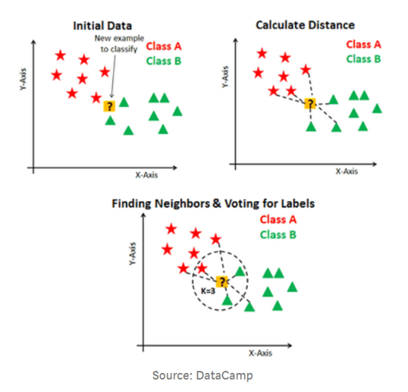
Lazy vs. Eager Learning
Lazy vs. eager learning
Lazy learning (e.g., instance-based learning): Simply stores training data (or only minor processing) and waits until it is given a test tuple
Eager learning (the above discussed methods): Given a set of training set, constructs a classification model before receiving new (e.g., test) data to classify
Lazy: less time in training but more time in predicting

Slide 16
Types of Classification
Non-probabilistic e.g, kNN
Probabilistic
Discriminative approach Ex: Logistic Regression
Generative approach Ex: Naïve Bayes
Discriminant Functions Ex: SVM
Tree-based Models Ex: Decision Tree
13

Slide 17
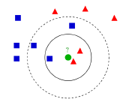
Non-Probabilistic – Classification Using Distance
Place items in class to which they are “closest”
Must determine distance between a new instance and training instances
New instance is assigned to the class most common among its k nearest neighbors
E.g. KNN

Slide 18
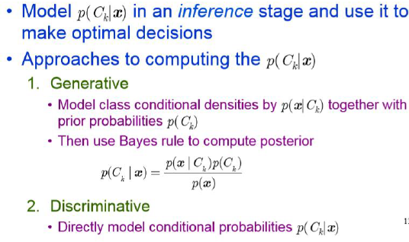
Probabilistic Models: Generative/Discriminative

Slide 19










Probabilistic Generative Model versus Probabilistic Discriminative Model
Generative: Discriminative:
x₂
x₂
Decision Boundary
x₁
x₁

Slide 20
Probabilistic Generative Model versus Probabilistic Discriminative Model
Generative Model | Discriminative Model
Derive joint probability distribution using training data | Derive conditional probability from training data
Requires considerably large training set to generate an decent model | Can work with moderate sized data as well, since the conditional probability is drawn from given input set directly
Models the actual distribution of each class | Models the decision boundary between classes
Use Bayesian theory to assign input to a class | Use maximum likelihood to assign an input to a class
Probabilistic
Probabilistic Disc
Generative Vs
riminative Models

Slide 21
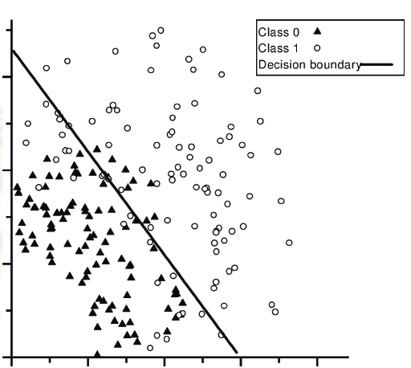
Discriminant Functions
Discriminant is a function that maps input vector directly to a class label.
Linear discriminant is a linear function, whose decision surface is a hyperplane
It focuses on maximizing the separability among known classes

Slide 22
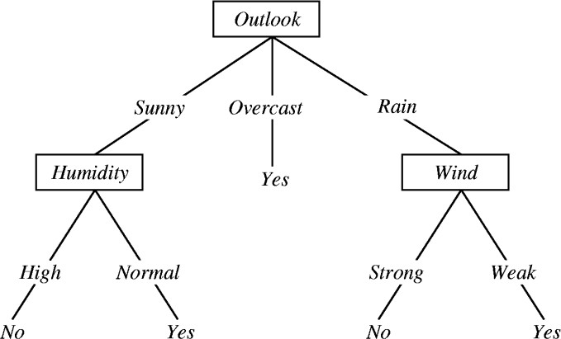
Tree based Model - Decision Tree
Leaf represents class label
Decisions are (internal) nodes/ branches
Supervised learning for classification / regression
Can handle categorical and continuous data
Little preprocessing needed

Slide 23
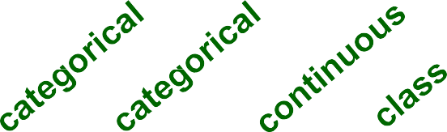
Example of a Decision Tree
Splitting Attributes
Tid | Refund | Marital Status | Taxable Income | Cheat
1 | Yes | Single | 125K | No
2 | No | Married | 100K | No
3 | No | Single | 70K | No
4 | Yes | Married | 120K | No
5 | No | Divorced | 95K | Yes
6 | No | Married | 60K | No
7 | Yes | Divorced | 220K | No
8 | No | Single | 85K | Yes
9 | No | Married | 75K | No
10 | No | Single | 90K | Yes
Refund
Yes
No
NO
MarSt
Single, Divorced
Married
TaxInc
NO
< 80K
> 80K
NO
YES
10
Training Data
Model: Decision Tree

Slide 24
Apply Model to Test Data
Test Data
Start from the root of tree.
Refund | Marital Status |  |  | Taxable Income | Cheat
No | Married |  | 80K |  | ?
Refund
10
Yes
No
NO
MarSt
Single
Married
TaxInc
NO
< 80K
> 80K
NO
YES

Slide 25
Apply Model to Test Data
Test Data
Refund | Marital Status |  |  | Taxable Income | Cheat
No | Married |  | 80K |  | ?
Refund
10
Yes
No
NO
MarSt
Single
Married
TaxInc
NO
< 80K
> 80K
NO
YES

Slide 26
Apply Model to Test Data
Test Data
Refund | Marital Status |  |  | Taxable Income | Cheat
No | Married |  | 80K |  | ?
Refund
10
Yes
No
NO
MarSt
Single
Married
TaxInc
NO
< 80K
> 80K
NO
YES

Slide 27
Apply Model to Test Data
Test Data
Refund | Marital Status |  |  | Taxable Income | Cheat
No | Married |  | 80K |  | ?
Refund
10
Yes
No
NO
MarSt
Single
Married
TaxInc
NO
< 80K
> 80K
NO
YES

Slide 28
Apply Model to Test Data
Test Data
Refund | Marital Status |  |  | Taxable Income | Cheat
No | Married |  | 80K |  | ?
Refund
10
Yes
No
NO
MarSt
Single
Married
TaxInc
NO
< 80K
> 80K
NO
YES

Slide 29
Apply Model to Test Data
Test Data
Refund | Marital Status |  |  | Taxable Income | Cheat
No | Married |  | 80K |  | ?
Refund
10
Yes
No
NO
MarSt
Married
Assign Cheat to “No”
Single
TaxInc
NO
< 80K
> 80K
NO
YES

Slide 30
Ensemble Methods
Bagging (Bootstrap AGGregating)
Boosting
AdaBoost (Adaptive Boosting)
XGBoost (eXtreme Gradient Boosting)
Random Forest

Slide 31
Main Challenges
Insufficient quantity of training data
Non-representative training data
Poor quality data
Irrelevant features
Overfitting the training data

Slide 32
Applications of Classification – Case Study Overview
Diabetes Mellitus prediction in women
Two-class problem (yes/no classification)
Data set – 768 patients with health records and family history as parameters
Input attribute set
Pregnancies
Glucose
Blood Pressure
Skin Thickness
Insulin
BMI
Age
Label - Outcome (diabetic or non-diabetic)

Slide 33
Python Programming
Python’s main scientific libraries
NumPy (https://numpy.org/)
Pandas (https://pandas.pydata.org/)
Matplotlib (https://matplotlib.org/)
Seaborn (https://seaborn.pydata.org/introduction.html)
Scikit-Learn (https://scikit-learn.org/)
To learn Python (https://www.learnpython.org/)

Slide 34
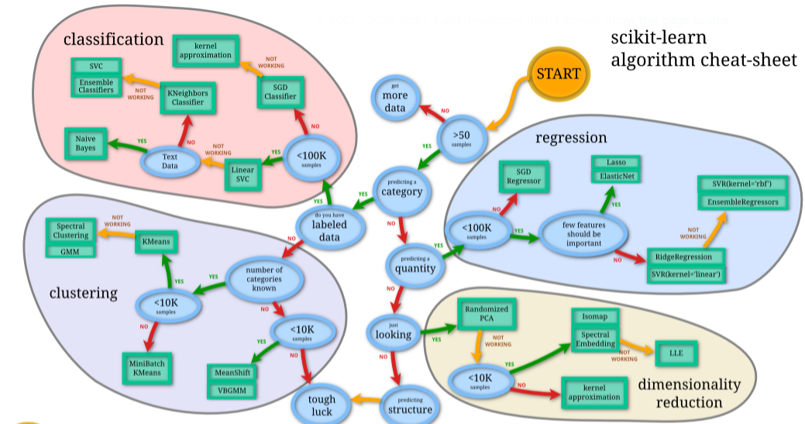
Source

Slide 35
End-to-End ML Project – Extra Slide
Look at the big picture
Get the data
Data preprocessing/ Feature Engineering
Select and train a model
Fine tune your model
Launch, and maintain your system

Slide 36
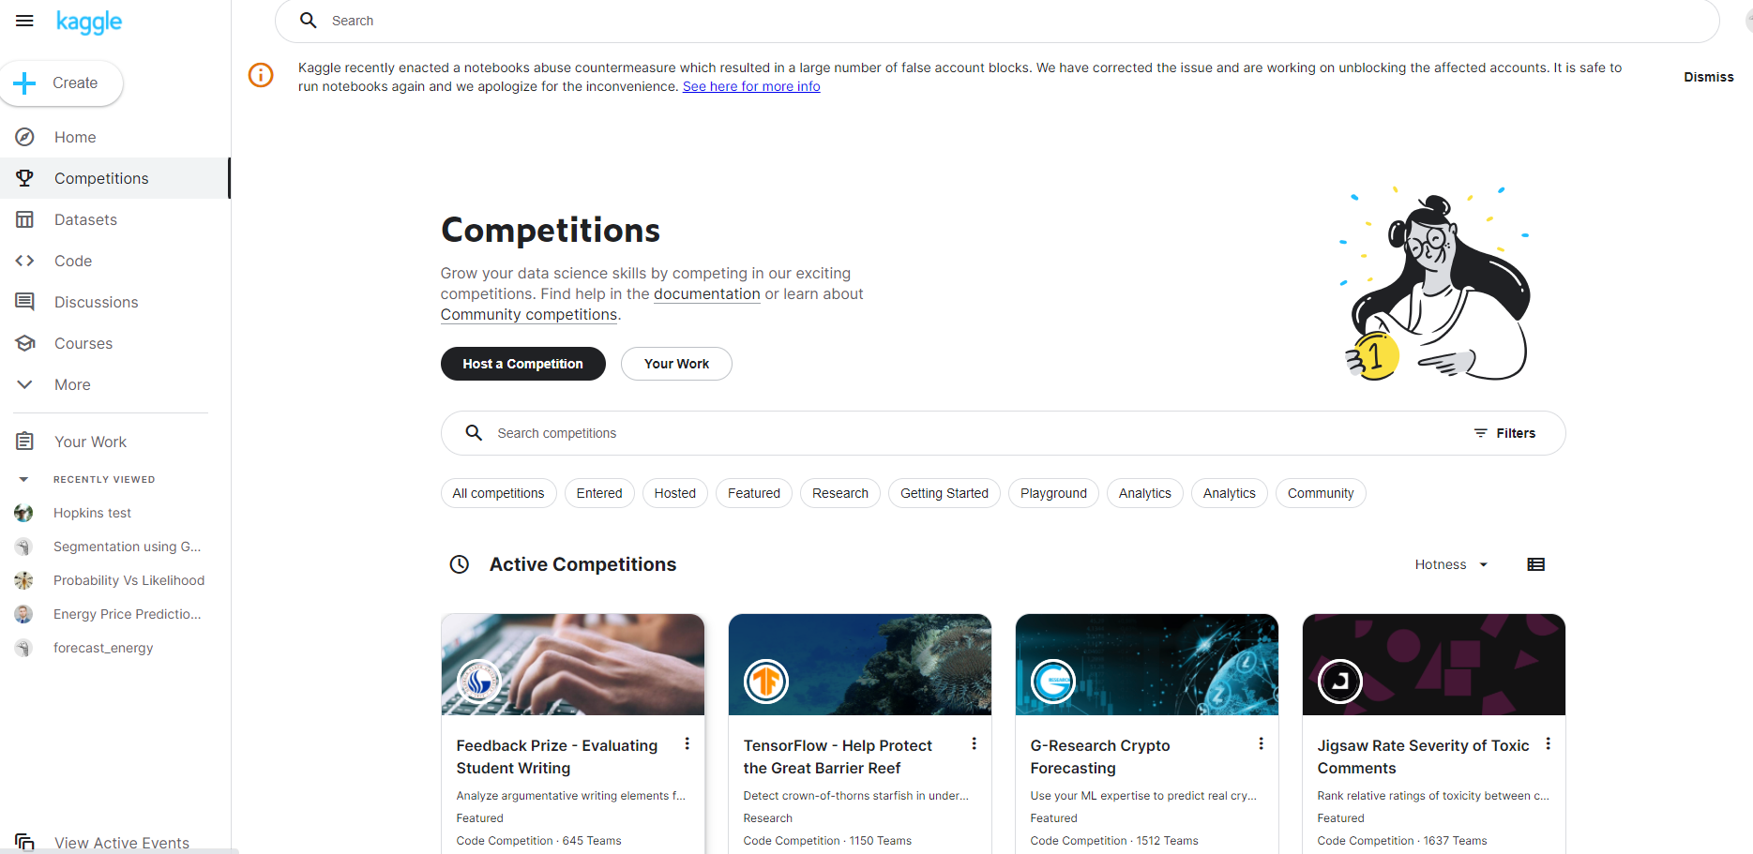
AI/ML Hackathons
Kaggle

Slide 37
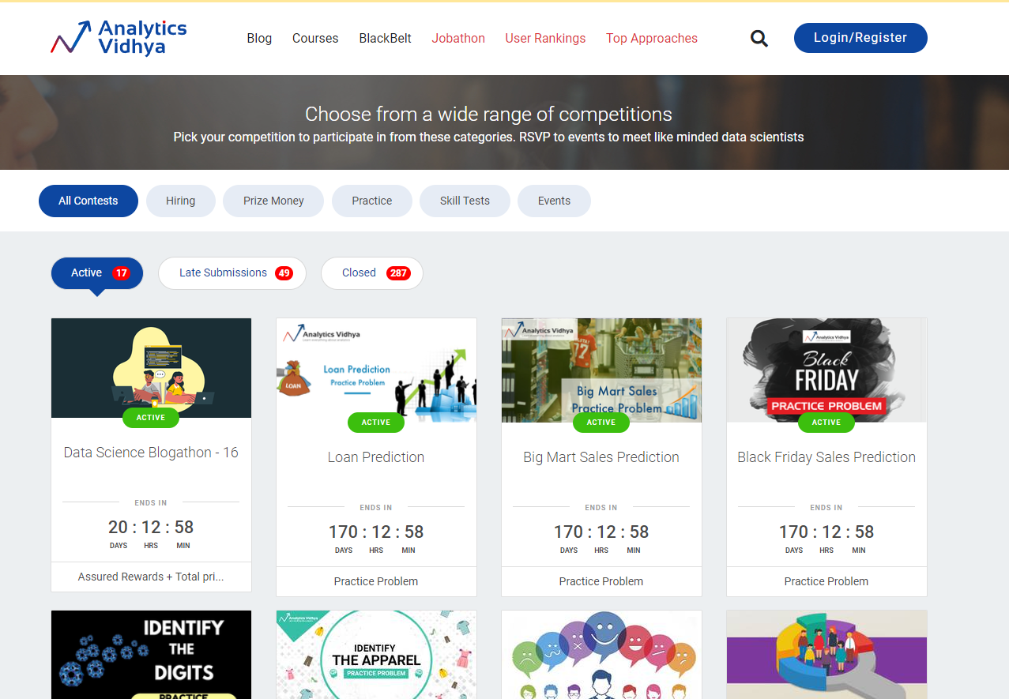
AI/ML Hackathons
DataHack by Analytics Vidhya

Slide 38

AI/ML Hackathons
Machine Hack

Slide 39
Thank You
BITS Pilani, Pilani Campus

